Slide 1
Course Name: Database Management System
Course Code: CS116
Dr. Praveen Kantha

Slide 2
NORMALIZATION

Slide 3
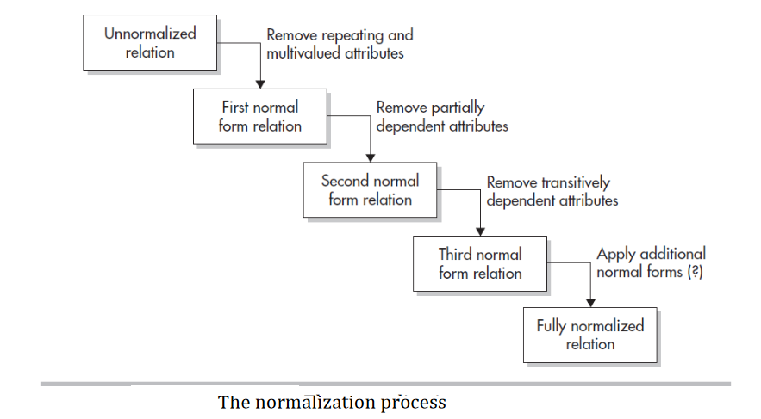

Slide 4
Functional Dependency
Functional dependencies are fundamental to the process of normalization.
An attribute is functionally dependent if its value is determined by another attribute.
It is concerned with a particular semantic relationship between the attributes of a relationship.
It typically exists between the primary key and non-key attribute within a table.
Functional dependencies are expressed as
X → Y
The left side of FD is known as a determinant, the right side of the production is known as a dependent.

Slide 5
For example:
Assume we have a customer table with attributes: Cust_id, Cust_Name, Cust_Address.
Here Cust_id attribute can uniquely identify the Cust_Name attribute of the customer table because if we know the Cust_id, we can tell that the customer name associated with it.
Functional dependency can be written as:
Cust_id → Cust_Name
If we write below the functional dependency then it is not True
Cust_Name → Cust_id
Because the name of the customer may be the same for different Cust_id.

Slide 6
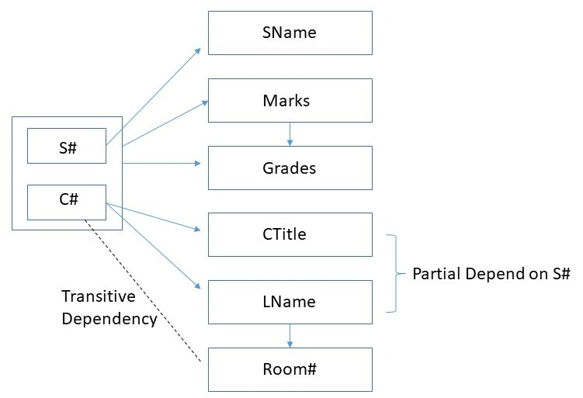
Example of Functional Dependency:
Consider the following relation:
Report (S#, Sname, C#, Ctitle, Lname, Room#, Marks, Grade)
S# → Sname
C# → Ctitle
C# → Lname (Assuming one course is taught by only one instructor)
Lname → Room# (Assuming each instructor has his/her room)
S#,C# → Marks
Marks → Grade
S#,C# → Grade

Slide 7
Types of Functional Dependencies
Full Functional Dependency
Partial Functional Dependency
Transitive functional dependency
Trivial and Non-Trival Functional Dependency

Slide 8
Full Functional Dependency
Rules :
If there is a relation R having attributes X and Y and X is functionally determined Y
X→ Y
If X is a composite attribute then a subset of X should not functionally determine Y
In Simple word: if the removal of any attribute A from X removes the dependency.

Slide 9
A
B
C
SID | Name | Age
1 | Raj | 17
2 | Raj | 23
3 | Kapil | 22
Here, A ->B # We define from A to B
A-> C # We define from A to C
If we remove A then we can’t define B and C.
So B and C fully depend on A
We can say Nonkey is fully dependent on the prime key.

Slide 10
As per the above definition:
Here in relation R having attributes X, Y and X is a composite attribute(S#, C#) and Y attribute is {Marks}.
The subset of X composite attribute {S#},{C#} alone not functionally determine
Y attribute(Marks)

Slide 11
Marks is fully functionally dependent on S#, C# and not a subset of S#, C#
This means Marks can’t be determined either by S# or C# alone.
It can be determined only using S# and C# together.
Hence, Marks is fully dependent on S#,C#

Slide 12
Partial Functional Dependency
Rules :
If there is a relation R having attributes X and Y.
Attribute Y is partially dependent on the attribute X only if it is dependent on a subset of attribute X
In Simple Words “Partial dependency refers to a situation in which a non-key attribute in a relational database table depends only on part of the primary key, instead of the entire key”
If there is a relation R having attributes X and Y and X is functionally determined Y
X→ Y
If X is a composite attribute then a subset of X should not functionally determine Y

Slide 13
PK
CK
SID | CLASS | NAME | AGE
1 | 11 | RAJ | 17
2 | 12 | RAJ | 15
Suppose, A = {SID, CLASS}
B = {NAME, AGE}
Rule: if we remove one attribute then the dependency is maintained then we can say it is partial.
{SID} -> {NAME}
{SID} -> {AGE}
{CLASS} -> {NAME}
{CLASS} -> {AGE}
{SID,CLASS} -> {NAME}
{SID,CLASS} -> {AGE}
So it is a Partial dependency

Slide 14
Here non-key attribute (CTitle+ Lname ) depend only primary key(C#),instead of the entire key (S#, C#)
Here, (CTitle+ Lname ) is dependent on c#.
Hence, (CTitle+ Lname ) will be partially dependent on S#

Slide 15
Transitive Functional Dependency
Rules :
In a given relation R, there are three attributes X, Y, and Z.
Y is functionally dependent on X and Z is functionally dependent on Y.
Therefore there is an indirect dependency between X and Z. This is called (indirect) dependency
X → Y
Y → Z
X → Z

Slide 16
X → Y
Y → Z
X → Z
LNAME → Room#
C# → Lname
C# → Room#
Marks → Grade
S#C# → Marks
S#C# → Grade
Here Room# transitive dependent on C#
Here Grade transitive dependent on S#C#

Slide 17
Trivial functional dependency
In Trivial Functional Dependency, a dependent is always a subset of the determinant.
i.e. If X → Y and Y is the subset of X, then it is called trivial functional dependency
roll_no | name | age
42 | abc | 17
43 | pqr | 18
44 | xyz | 18
Example:
Here,
{roll_no, name} → {name} is a trivial functional dependency since the dependent name is a subset of determinant set {roll_no, name}.
{name} → {name} is a trivial functional dependency since the dependent name is a subset of determinant set {name} itself.

Slide 18
Non-Trivial functional dependency
In Non-trivial functional dependency, the dependent is strictly not a subset of the determinant.
i.e. If X → Y and Y is not a subset of X, then it is called Non-trivial functional dependency.
roll_no | name | age
42 | abc | 17
43 | pqr | 18
44 | xyz | 18
Example:
Here,
roll_no → name is a non-trivial functional dependency since the dependent name is not a subset of determinant roll_no.
{roll_no, name} → age is also a non-trivial functional dependency since age is not a subset of {roll_no, name}

Slide 19
Consider a relation R (N,P, Q,R,W) and
FDs {PQW→ T, P → R, T → N, R → R}.
Find out :
1. Trivial Functional Dependency
2. Non-trivial Functional Dependency
3. Transitive dependency

Slide 20
Consider a relation R (N, P, Q, R, W) and
FDs {PQW→ T, P → R, T → N, R → R}.
1. Trivial Functional Dependency : R → R
2.Non-trivial Functional Dependency : PQW→ T, P → R, T → N
3. Transitive dependency : PQW → N

Slide 21
Functional Dependency – Armstrong’s Axioms Property
Armstrong's Axioms is a set of rules.
It provides a simple technique for reasoning about functional dependencies.
It was developed by William W. Armstrong in 1974.
It is used to infer all the functional dependencies on a relational database.

Slide 22
Various Axioms Inference Rules
A. Primary Rules
Rule 1 | Reflexivity If Y is a subset of X, then X → Y holds by the reflexivity rule. e.g. Let X represents {E-ID, E-NAME} and Y represents {E-ID}. {E-ID, E-NAME}->E-ID is true for the relation.
Rule 2 | Augmentation: It is also known as a partial dependency. If X → Y, then XZ → YZ. e.g.; Let X represents {E-ID}, Y represents {E-NAME} and Z represents {E-CITY}. As {E-ID}->E-NAME is true for the relation, so { E-ID, E-CITY}->{E-NAME, E-CITY} will also be true. This axiom demonstrates that adding attributes to dependencies does not alter the fundamental dependencies. If A→B holds, AC→BC holds for any set of attributes C.
Rule 3 | Transitivity If A holds B and B holds C, then A holds C. If {A → B} and {B → C}, then {A → C} A holds B {A → B} means that A functionally determines B.

Slide 23
B. Secondary Rules
Rule 1 | Union If A holds B and A holds C, then A holds BC. If{A → B} and {A → C}, then {A → BC}
Rule 2 | Decomposition If A holds BC and A holds B, then A holds C. If{A → BC} and {A → B}, then {A → C}
Rule 3 | Pseudo Transitivity If A holds B and BC holds D, then AC holds D. If{A → B} and {BC → D}, then {AC → D}

Slide 24
Closure of attribute set and closure of functional dependency set
The closure method is used to find all possible candidate keys in the table.
A candidate key is the minimal key which can determine all the attributes in the relation.
The set of all those attributes that can be functionally determined from an attribute set is called a closure of that attribute set.
It is denoted by X⁺ which means what X can determine.
Pseudocode to find Closure of an Attribute?
Determine X⁺, the closure of X under functional dependency set F
X Closure : = will contain X itself;
Repeat the process as:
old X Closure : = X Closure;

Slide 25
Steps to Find Closure of an Attribute Set-
Following steps are followed to find the closure of an attribute set-
Step-01:
Add the attributes contained in the attribute set for which closure is being calculated to the result set.
Example : A⁺ = { A }
Step-02:
Recursively add the attributes to the result set which can be functionally determined from the attributes already contained in the result set.

Slide 26
Example-
Consider a relation R ( A , B , C , D , E , F , G ) with the functional dependencies-
A → BC
BC → DE
D → F
CF → G
Now, let us find the closure of some attributes and attribute sets-
Closure of attribute A+
A+ = { A }
= { A , B , C } ( Using A → BC )
= { A , B , C , D , E } ( Using BC → DE )
= { A , B , C , D , E , F } ( Using D → F )
= { A , B , C , D , E , F , G } ( Using CF → G )
Thus,
A+ = { A , B , C , D , E , F , G }

Slide 27
Consider a relation R ( A , B , C , D , E , F , G ) with the functional dependencies-
A → BC
BC → DE
D → F
CF → G
Now, let us find the closure of some attributes and attribute sets-
Closure of attribute set { B , C }⁺
{ B , C }⁺ = { B , C }
= { B , C , D , E } ( Using BC → DE )
= { B , C , D , E , F } ( Using D → F )
= { B , C , D , E , F , G } ( Using CF → G )
Thus,
{ B , C }⁺ = { B , C , D , E , F , G }

Slide 28
Finding the Candidate Keys Using Closure
List all the candidate keys of the following relation
R ( A , B , C , D , E , F ) with the functional dependencies-
A → C
C → D
D → B
E → F
Solution:
FIRST:
Here, We first check which attributes are in RHS.
This means all the attributes in RHS which is already determined.
We find which attribute is not in RHS.
This attribute always present in candidate key which is AE
SECOND:
To check whether it is candidate key we take closure of {AE⁺}
{AE⁺} ={AECDBF} # Complete relation
So AE is candidate key

Slide 29
List all the candidate keys of following relation
R ( A , B , C , D , E , F ) with the functional dependencies-
A → B
AB → C
BC → E
BD → E

Slide 30
Rules for Candidate keys
Step 1: Start from any attribute, find closure for each.
Step 2: Focus on finding 1st candidate Key
Step 3: Search for Prime Attribute in RHS of given FDs, If we find a replacement prime
attribute with LHS.
Step 4: Make Sure all your Candidate Keys are minimal.
Note: Prime Attribute (PA): Prime Attributes (attributes of CKS).
e.g. If we san say AB is a Candidate keys then A and B are Prime Attribute

Slide 31
Find The Candidate Key If R(A, B, C, D, E) and
FIRST:
We first check which attributes are in RHS.
This means all the attributes in RHS which is already determined.
We find which attribute is not in RHS.
That can be the Candidate Key.
Here all attributes available in RHS
=> Continue.
FDs
A - > BC
CD - > E
B - > D
E - > A

Slide 32
THEN:
Step 1:
Start from any attribute, and find closure for each.
Step 2:
Focus on finding 1st candidate key
so, take closure of (A+)=ABCDE # Complete Relation
Here we found one candidate key A
FDs
A->BC
CD->E
B->D
E->A

Slide 33
Step : 3
We replace A with E because E->A
find the closure of (E+)=EABCD # Complete Relation
*** Here we found another candidate key E ***
Again
We E replace with CD because CD -> E
find the closure of (CD+)=CDEAB # Complete Relation
*** Here we found another candidate key CD ***
We D replace with B because B->D
find the closure of (CB+)=CBDEAB # Complete Relation
*** Here we found another candidate key CB ***
CANDIDATE KEYS
A
E
CD
CB

Slide 34
Canonical Cover
Simplified and reduced version of the given set of Fds
It is also known as an irreducible set
In canonical cover, many inference rules will apply
Characteristics:
Working with the set containing extraneous Fds increases the computational time
Advantage:
Reduces the Computation

Slide 35
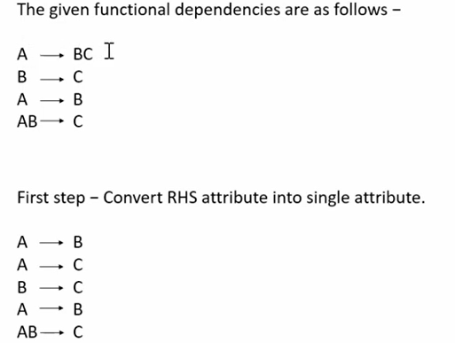

Slide 36
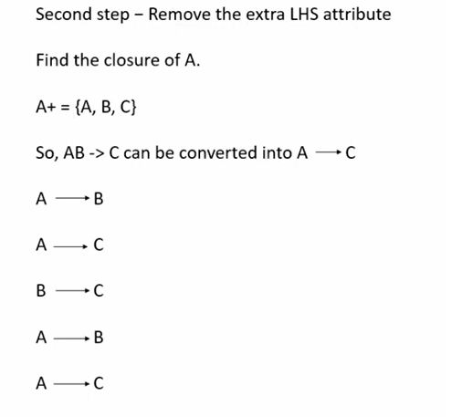
A -> BC
B -> C
A -> B
AB -> C
# Here B is Extra so remove it because we have B -> C
In given FDs

Slide 37
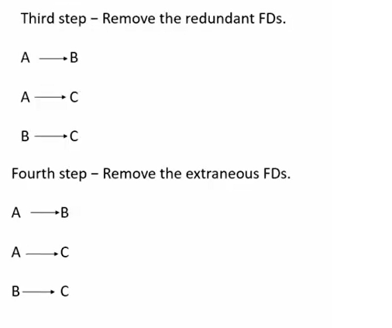
A -> BC
B -> C
A -> B
AB -> C

Slide 38
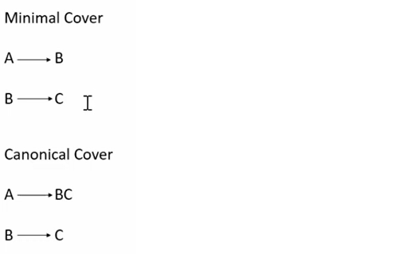
# Here, As we know we got A - > C FROM A -> B and B -> C
so,
Remove A ->C
In given FDs

